Slide 1


Module Introduction
Aims and educational overview of the module

Slide 2


Slide 3

What does this module aim to do?
The module aims to improve your programming skills.
How does it aim to do this?
The module will help you to develop a gaming app...
... assessment is 100% project based

Slide 4
Some useful information about my lecturing style…
I don’t want to talk at you for an hour
I really do want to hear your thoughts and opinions
I like asking questions, but I don’t like asking questions with a right/wrong answer
I’m friendly, honest!

Slide 5
Some utterly irrelevant information about me…
I’ve a collection of classic Intel processors displayed on my office wall (check the picture).
I’ve logged a LOT of time playing Team Fortress 2.
As a kid I wanted to grow up and become a mad scientist. Mission nearly accomplished.

Slide 6

Learning on this module

Slide 7

: Pen and Paper at the Ready
Answer the following questions in a couple of words:
Q1: Write down something new that you learnt to do recently…
Q2: Write down the reasons why you learnt this…
Q3: Write down how you learnt this…

Slide 8

: How you and I (and everyone else) learns
People learn things because they are either useful or fun
People learn things by doing them and getting better through practice.
Consequentially, for this module...

Slide 9
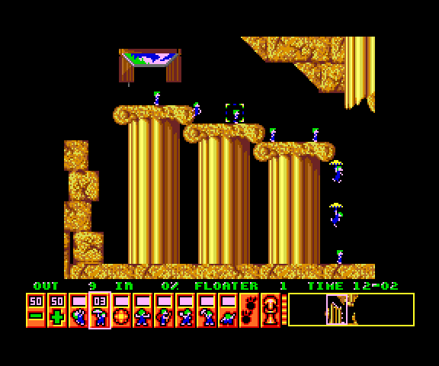
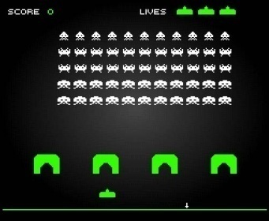
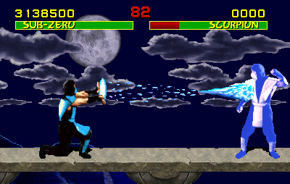

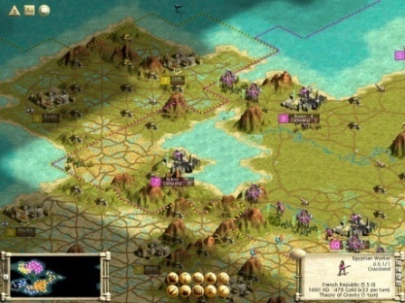


The entire course is focused on developing a project...
... programming is a practical activity, i.e. best learnt by doing. Your time is best spent writing code. Lectures will be used to support the project.
You get to select your own project ...
... you know best what games you find fun and want to explore.
What you will learn will likely be of considerable use on your placement year and in other programming modules. Trust me on this.

Slide 10

Learning Contract

Slide 11

Things which you can expect of me:
In general: ○ I’m here to help
○ I will be supportive and non-judgemental
Within lectures: ○ I won’t regurgitate material within lectures.
○ I’m very happy to answer questions
Assessment: ○ I will be fair, honest and consistent in all assessment
Things which I will expect of you:
○ You will attend lectures and explore the weekly study packs
○ You will work on your project throughout the duration of the module
Learning
Contract

Slide 12

Module Contents and Structure

Slide 13

A number of different programming topics will be explored, as follows:
Android App Development
Performance & Efficiency
Contemporary Software Development
2D Game Development
User Experience Design

Slide 14

Contemporary Software Development
We will explore and practice some of the key fundamentals underpinning agile and lean software development. We will also explore how to work effectively within a team.

Slide 15

Android App Development
We will delve into Android app development, focussing on the types of interaction the user can have with their tablet and how we render a game world on screen.

Slide 16

2D Games Programming
We will study a range of 2D game programming topics: game architectures, graphical effects, collision detection, artificial intelligence, etc.

Slide 17

Performance & Efficiency using C++
We will use C++ to understand how code is executed and how data is set out in memory as a means of more deeply understanding the execution of our programs.
From this we will be able to write faster and hence more efficient code in virtually all programming languages.

Slide 18

User Experience (UX) Design
We will finally consider how we interact with software, in terms of what we are likely to see, what we often miss, how we think about problems, etc.
UX Design

Slide 19

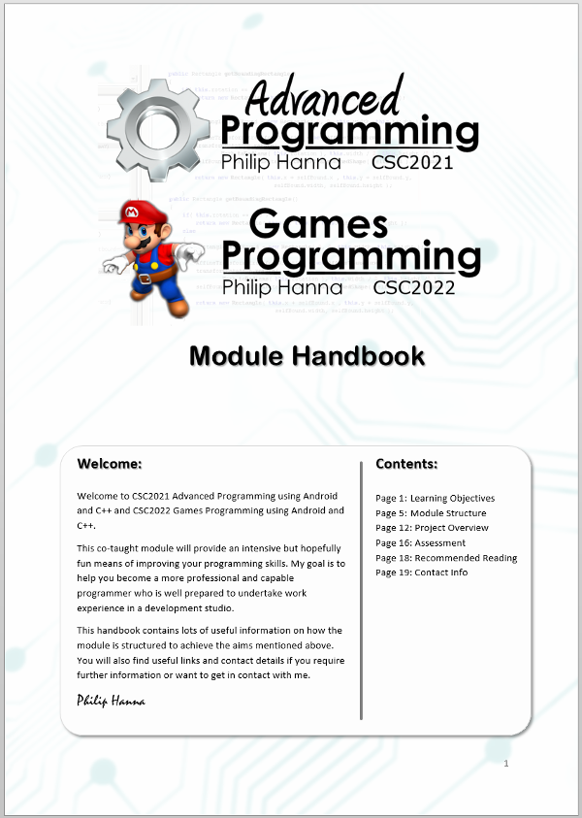
Have a read of the module handbook for more information. It contains lots of important information, including:
Learning Objectives
Module Structure
Project Overview
Assessment
Recommended Reading
Contact Info
To do:
Read this

Slide 20

Recommended Reading

Slide 21


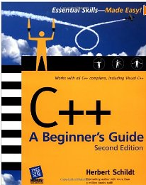
Android Programming: The Big Nerd Ranch Guide
Big Nerd Ranch Guides; 1st Ed. (2013)
Beginning Android Games
Springer; 2nd Ed. (2012)
C++: A Beginner's Guide (2nd Ed.)
McGraw-Hill Osborne (2003)

Slide 22

Lecture Times and Important Dates

Slide 23
First Semester Lecture Times:
Monday 10:00 – 11:00 ECS2/0G/006
Tuesday 13:00 – 14:00 ECS2/0G/006
Thursday 13:00 – 14:00 ECS2/0G/006
Optional drop-in advisories will be held in my office (01 006 / 14 Malone Road)
Monday 14:00-15:00
Thursday 16:00-17:00
See handbook for second semester dates

Slide 24
Important Dates:
Friday 17th October
Friday 28th November
Monday 2nd February
Friday 20th February
Monday 16th March
17th-20th March
Team formation and initial game concept hand-in.
Sprint 2 Submission (Architecture)
Sprint 3 Submission
Sprint 4 Submission
Final full game submission
Assurance vivas

Slide 25

Student-to-student advice

Slide 26
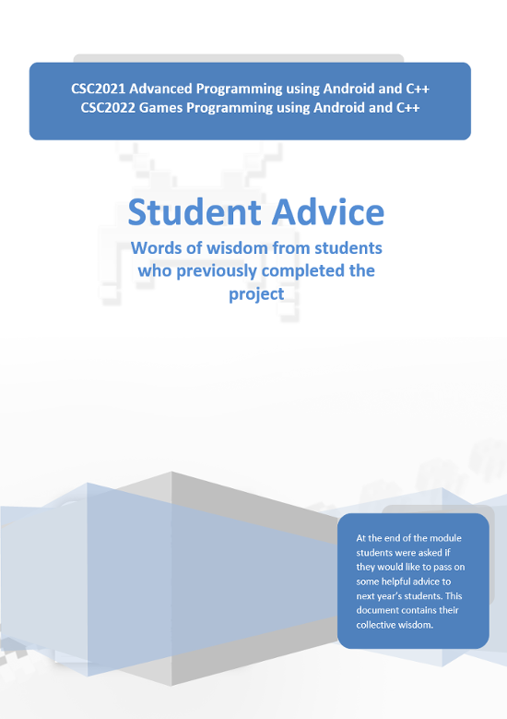
Each year students are asked to reflect on their experiences of the module and pass on some useful advice to future cohorts taking the module.
The information provided by students is incredibly valuable – although, it is only valuable if you actually act upon the advice…
To do:
Read this

Slide 27

Key takeaways:
The aim of this module is to make you a more capable and competent software developer.
Carefully read the module handbook. It provides lots of useful information about the module.
Do read the feedback provided by previous cohorts of students.

